Slide 1
Machine Learning for Mere Morals
Dev Nambi
Data Geek
University of Washington
@DevNambi
me@devnambi.com
Notes:
Message:
Story To Tell:

Slide 2


Slide 3
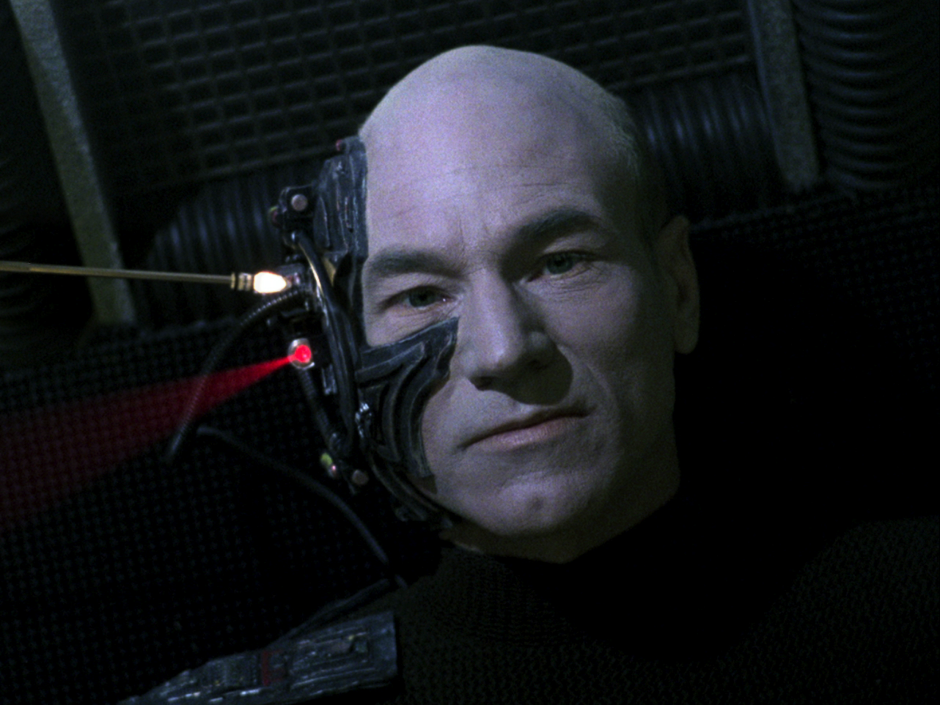
Resistance is Futile
Notes:
Message:
Story To Tell:
It’s everywhere:
Amazon recommendations
Google Search, Images, Translate
Facebook (‘People You May Know’)
Netflix recommendations
Email (spam filter)
Banks (fraud detection)
Science (image analysis, weather forecasting)
Retailers (product placement)

Slide 4
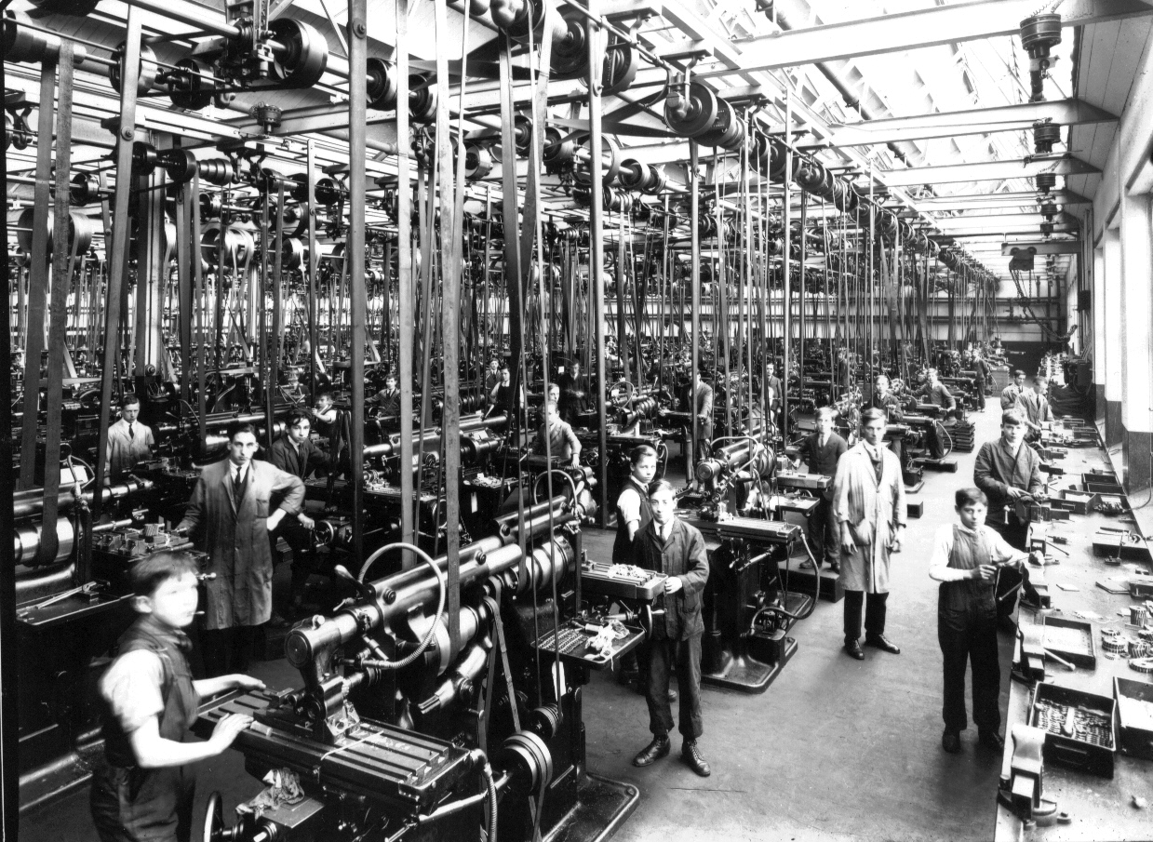
What’s with this newfangled machine learning, anyways?
Notes:
Message:
Story To Tell:
Why Does it Exist:
You don't write the rules. You write the math. The data informs the math to create the rules
"How can we build computer systems that automatically improve with experience, and what are the fundamental laws that govern all learning processes?"
History
- So old that it has the term 'machine' in it
- Comes from artificial intelligence. First came in the 40's.
- AI itself is mostly a failure.
- Goes back to the Turing Test

Slide 5
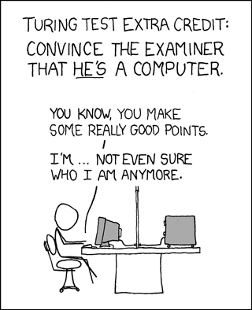

Slide 6
Notes:
From https://www.isc.org/solutions/survey/history

Slide 7


Slide 8
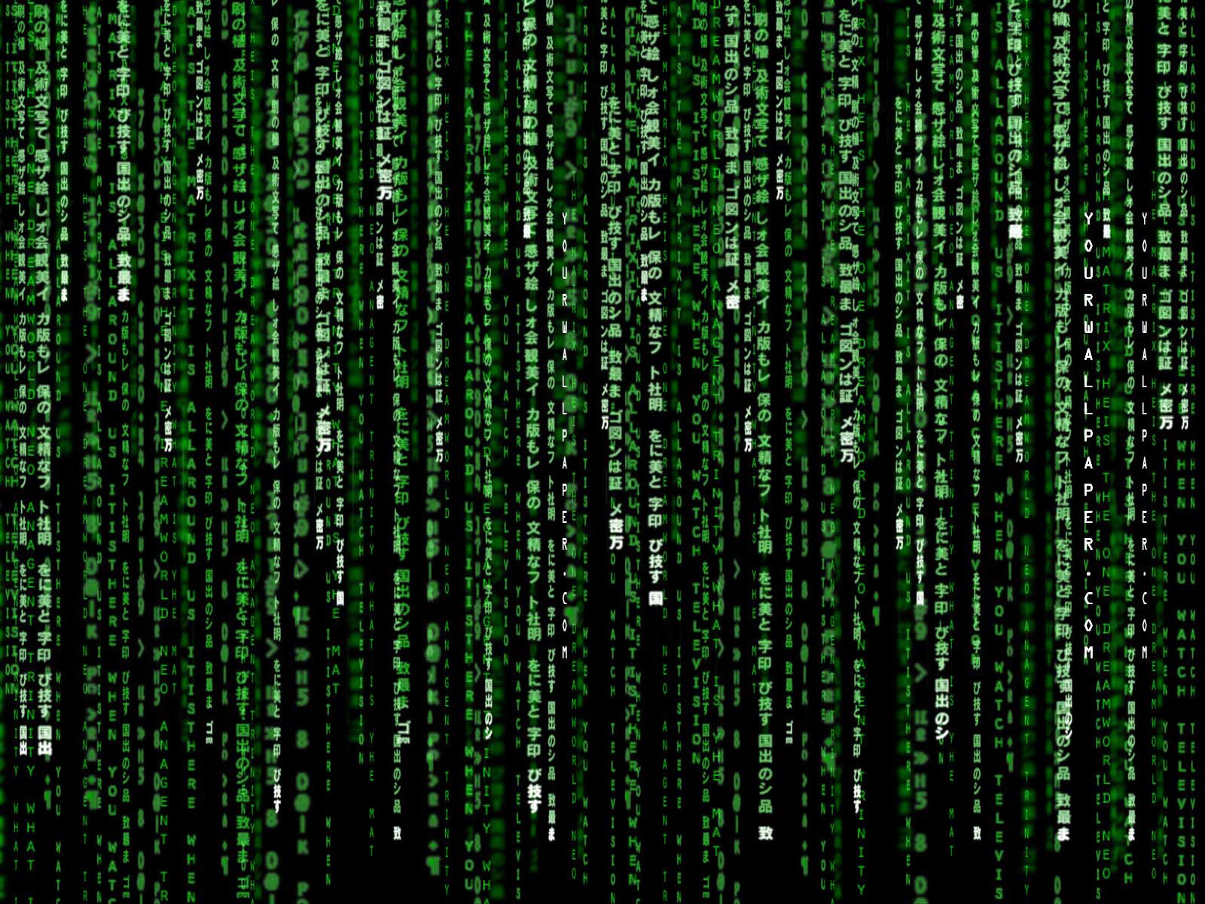
The Matrix is Everywhere
Student | Class 1 | Class 2
Student 1 | 3.4 | 4.0
Student 2 | 3.0 | 2.2
Student 3 (new) | 3.2 | 3.6
(Compute the distance between each row)
Student | Class 1 | Class 2 | Class 3 | Age
Joe | 3.3 | 2.1 | 3.0 | 18
Jim | 2.0 | 3.2 | 3.7 | 21
Suzy | 3.9 | 3.6 | 2.2 | 29
Jane | 1.9 | 3.5 | 4.0 | 17
Bob | 4.0 | 1.9 | 3.3 | 19
Amanda | 2.2 | 4.0 | 3.2 | 20
Notes:
Matrix math
Word similarity
Classes are like each other
Students like each class

Slide 9
Server | Median CPU Load | Median RAM Used | Median IOPS | Variation
Server A | 20% | 8GB | 100K | 4%
Server B | 2% | 20GB | 2M | 50%
Server C | 90% | 4GB | 100 | 5%
Server D | 10% | 15GB | 4M | 8%

Slide 10

You Can Do Math
Sum()
Notes:
Message:
Story To Tell:
Math isn’t hard
Writing code is math. Just another set of semantics.
SUM() is the same as E[]
Bayes Law P (B | A) = P(A | B) X P(B) / P(A) Example: This works for your spam filter

Slide 11
Clustering
Notes:
Message:
Story To Tell:
Clustering
Unsupervised learning
Demo (k-means)

Slide 12
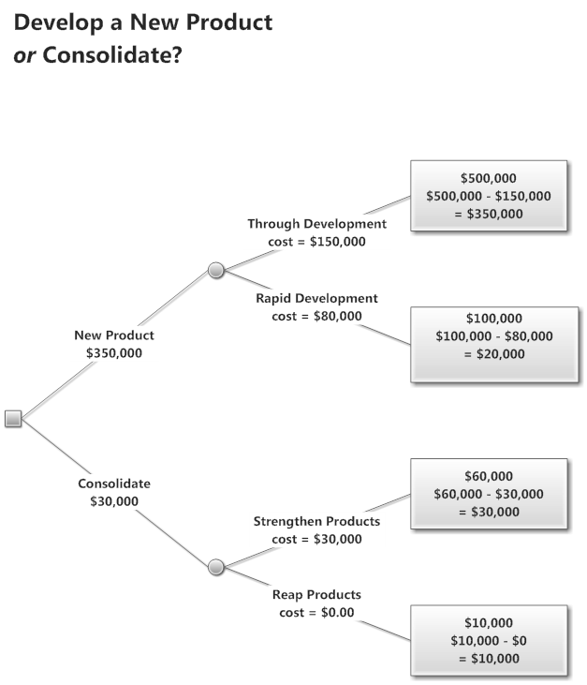
Decision Trees
Notes:
Message:
Story To Tell:
Decision Trees
Supervised learning
Demo (random forest)

Slide 13
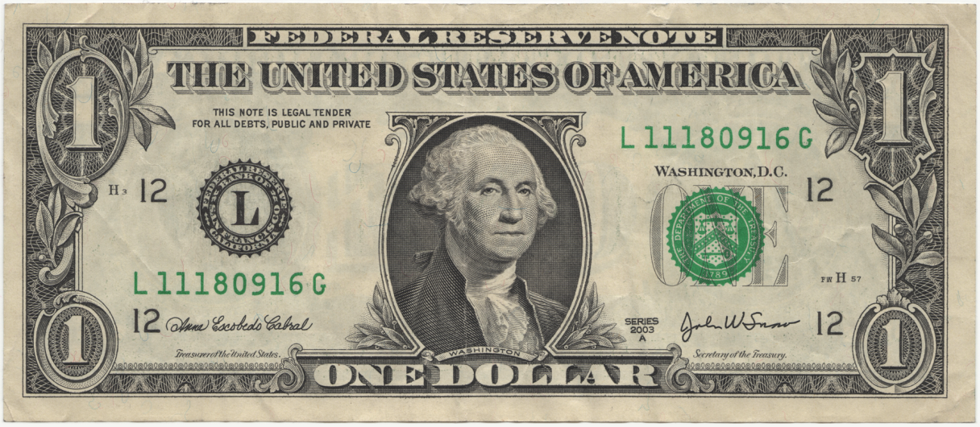

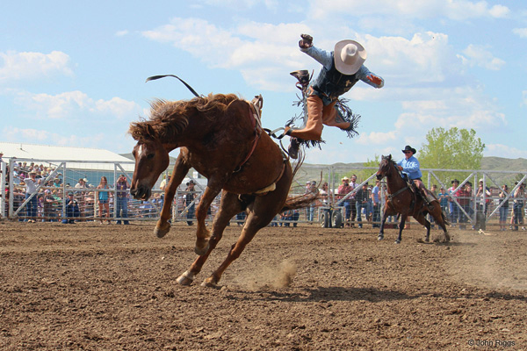
Entity Disambiguation

Slide 14
Signal / Noise
Notes:
Message: Machine learning is changing so quickly, and there’s so much hype, that the real lessons can be lost in the noise
Story To Tell:
Know math.
Use cross-validation
Curiosity is the best trait to cultivate
It’s fine to code first and think of math second. Just do both
Ask crazy questions of your data
The ML community is just as active as the SQL community. They’re just different people.
Use online sources (Strata, Twitter, blogs by experts) to learn
The most common ML techniques are decision trees, k-means clustering, and linear/logistic regression.
Know when you’ve won
Automating this process is NP hard. It’s computationally impossible to try all techniques and variations and ‘automagically’ get th right answer.
Because it’s changing so fast, personal traits can make up for experience, because experience is outdated so quickly
Curiosity
Knowledge of your own biases
Persistence

Slide 15
Resources
http://devnambi.com/data-science/
http://github.com/DevNambi
Notes:
Resources

Slide 16
Q&A
Notes:
Q&A

